Slide 1















CHAPTER 4
TREES
§1 Preliminaries
1. Terminology
Pedigree Tree
( binary tree )
Lineal Tree
1/16

Slide 2

§1 Preliminaries
【Definition】A tree is a collection of nodes. The collection can be empty; otherwise, a tree consists of
(1) a distinguished node r, called the root;
(2) and zero or more nonempty (sub)trees T₁, ⋅⋅⋅, T_{k}, each of whose roots are connected by a directed edge from r.
Note:
➢ Subtrees must not connect together. Therefore every node in the tree is the root of some subtree.
➢ There are edges in a tree with N nodes.
➢ Normally the root is drawn at the top.
N − 1
2/16

Slide 3
§1 Preliminaries
 degree of a node ::= number of subtrees of the node. For example, degree(A) = 3, degree(F) = 0.
A
B
C
D
E
F
G
H
I
J
 degree of a tree ::=
For example, degree of this tree = 3.
K
L
M
 parent ::= a node that has subtrees.
 children ::= the roots of the subtrees of a parent.
 siblings ::= children of the same parent.
 leaf ( terminal node ) ::= a node with degree 0 (no children). 
 level of a node ::= defined by letting the root be at level one. If a node is at level l the its child nodes are at level l+1. 
3/16

Slide 4
§1 Preliminaries
 path from n₁ to n_{k} ::= a (unique) sequence of nodes n₁, n₂, …, n_{k} such that n_{i} is the parent of n_{i+1} for 1 ≤ i < k.
A
B
C
D
 length of path ::= number of edges on the path.
E
F
G
H
I
J
 depth of n_{i} ::= length of the unique path from the root to n_{i}. Depth(root) = 1.
K
L
M
 height of n_{i} ::= length of the longest path from n_{i} to a leaf.
 height (depth) of a tree ::= height(root) = depth(deepest leaf).
 ancestors of a node ::= all the nodes along the path from the node up to the root.
 descendants of a node ::= all the nodes in its subtrees.
4/16

Slide 5
2. Implementation
§1 Preliminaries
❖ List Representation
A
( A )
B
C
D
( A ( B, C, D ) )
E
F
G
H
I
J
( A ( B ( E, F ), C ( G ), D ( H, I, J ) ) )
K
L
M
( A ( B ( E ( K, L ), F ), C ( G ), D ( H ( M ), I, J ) ) )
E
K
B
L
F
A
C
G
H
M
D
I
J
5/16

Slide 6
❖ FirstChild-NextSibling Representation (Left Child Right Sibling)
§1 Preliminaries
Element
A
FirstChild
NextSibling
N
B
C
D
A
N
B
C
D
E
F
G
H
I
J
E
F
G
H
I
J
N
N
N
N
N
N
N
K
L
M
K
L
M
N
N
N
N
N
Note: The representation is not unique since the children in a tree can be of any order.
6/16

Slide 7
§2 Binary Trees
【Definition】A binary tree is a tree in which no node can have more than two children.
Rotate the FirstChild-NextSibling tree clockwise by 45°.
A
45°
A
N
N
B
E
B
C
D
N
K
F
C
N
N
E
F
G
H
I
J
L
N
N
N
G
D
N
N
N
N
N
N
N
N
N
H
N
K
L
M
N
N
N
N
N
M
I
N
N
Element
Left
N
J
N
N
Left
Right
Right
7/16

Slide 8
A
A
N
B
C
D
B
C
D
N
E
F
G
H
I
J
E
F
G
H
I
J
N
N
N
N
N
N
N
K
L
M
K
L
M
N
N
N
N
N

Slide 9
A
N
B
C
D
N
E
F
G
H
I
J
N
N
N
N
N
N
N
A
K
L
M
N
N
N
N
N
B
A
E
C
N
B
E
F
G
D
K
K
F
C
N
N
L
N
L
H
N
G
D
N
N
N
N
H
M
I
M
N
I
N
J
N
J
N
N

Slide 10
Maximum Number of Nodes in BT
The maximum number of nodes on level i of a binary tree is 2^{i-1}, i>=1.
The maximum nubmer of nodes in a binary tree of depth k is 2^{k}-1, k>=1.
Prove by induction.
10

Slide 11
Relations between Number of Leaf Nodes and Nodes of Degree 2
For any nonempty binary tree, T, if n0 is the number of leaf nodes and n2 the number of nodes of degree 2, then n0=n2+1
proof:
Let n and B denote the total number of nodes & branches in T.
Let n0, n1, n2 represent the nodes with no children,
single child, and two children respectively.
n= n0+n1+n2, B+1=n, B=n1+2n2 ==> n1+2n2+1= n,
n1+2n2+1= n0+n1+n2 ==> n0=n2+1
11

Slide 12

Samples of Trees
Complete Binary Tree
A
A
1
A
B
B
2
B
C
C
Skewed Binary Tree
3
D
E
F
G
D
4
H
I
E
5
12

Slide 13
Full BT VS Complete BT
A full binary tree of depth k is a binary tree of depth k having 2^{k} – 1 nodes, k>=0.
A binary tree with n nodes and depth k is complete iff all of its nodes are filled except possibly the last level, where in the last level the nodes are filled from left to right .
A
A
B
C
B
C
D
E
F
G
D
E
F
G
H
H
I
J
K
L
M
N
O
I
Complete binary tree
Full binary tree of depth 4
13

Slide 14
Binary Tree Representations
If a complete binary tree with n nodes is represented sequentially, then for any node with index i, 1<=i<=n, we have:
parent(i) is at i/2 if i!=1. If i=1, i is at the root and has no parent.
left_child(i) is at 2i if 2i<=n. If 2i>n, then i has no left child.
right_child(i) is at 2i+1 if 2i +1 <=n. If 2i +1 >n, then i has no right child.
14

Slide 15
Sequential Representation
[1]
[2]
[3]
[4]
[5]
[6]
[7]
[8]
[9]
A
B
C
D
E
F
G
H
I
(1) waste space
(2) insertion/deletion
problem
A
[1]
[2]
[3]
[4]
[5]
[6]
[7]
[8]
[9]
.
[16]
A
B
--
C
--
--
--
D
--
.
E
B
A
C
B
C
D
D
E
F
G
E
H
I
15

Slide 16
Linked Representation
class node {
int data;
node *left_child, *right_child;
};
data
left_child
data
right_child
left_child
right_child
16

Slide 17
Tree Creation

Slide 18
Binary Tree Traversals
Let L, N, and R stand for moving left, visiting the node, and moving right.
There are six possible combinations of traversal
LNR, LRN, NLR, NRL, RNL, RLN
Adopt convention that we traverse left before right, only 3 traversals remain
LNR, LRN, NLR
inorder, postorder, preorder
18

Slide 20

Arithmetic Expression Using BT
+
inorder traversal
A / B * C * D + E
infix expression
preorder traversal
+ * * / A B C D E
prefix expression
postorder traversal
A B / C * D * E +
postfix expression
level order traversal
+ * E * D / C A B
*
E
*
D
/
C
A
B
20

Slide 21
Inorder Traversal (recursive version)
void inorder(node *root)
/* inorder tree traversal */
{
if (ptr) {
inorder(root->left_child);
cout<<root->data;
indorder(root->right_child);
}
}
A / B * C * D + E
21

Slide 22
Preorder Traversal (recursive version)
void preorder(node *root)
/* preorder tree traversal */
{
if (root) {
cout<<root->data;
preorder(root->left_child);
predorder(root->right_child);
}
}
+ * * / A B C D E
22

Slide 23
Postorder Traversal (recursive version)
void postorder(node *root)
/* postorder tree traversal */
{
if (root) {
postorder(root->left_child);
postdorder(root->right_child);
cout<<root->data;
}
}
A B / C * D * E +
23

Slide 24
Iterative Inorder Traversal (using stack)
The iterative method to find the inorder traversal is as follows:
1. Prepare the stack and the binary tree.
2. Push the node into the stack and find the left child. If the left child is not NULL, push it into stack and find its left. Continue this process until you find the NULL left child.
3. If the left child is NULL, pop a node from the stack.
4. Print the node and find its right child. Then go to step 2 to repeat the process.
5. If the right child is NULL, pop a node from the stack and go to 4th step.
6. If the right child is NULL and the stack is empty, stop the traversal.

Slide 25

Iterative Inorder Traversal (using stack)
void iter_inorder(node *root)
{
int top= -1; /* initialize stack */
node stack[MAX_STACK_SIZE];
for (;;) {
for (; root; root=root->left_child)
push(root);/* add to stack */
root= pop();
/* delete from stack */
if (!root) break; /* empty stack */
cout<<root->data;
root = root->right_child;
}
}
25

Slide 26
Iterative Preorder Traversal (using stack)
The iterative method for preorder traversal is given below:
1. Prepare the stack and the tree.
2. Print the root information and push the root into the stack and move towards the left of the root until the root becomes NULL.
3. When the root reaches NULL, pop an element from the stack and check its right. If the right child node is existing, consider that as the root, then go to step 2.

Slide 27
Iterative Preorder Traversal (using stack)
4. If the right child is also NULL, pop an element from the stack.
5. Check the right child of the popped element. If it is present then go to step 2. If not present then pop an element from the stack.
6. Continue these steps until root reaches NULL and the stack is empty.

Slide 28
Iterative Preorder Traversal (using stack)
void itpre(node *r){
for(;;) {
for(;r;r=r->lcl) {
cout<<r->info<<" ";
s1.push(r);
}
r=s1.pop();
if(!r)break;
r=r->rcl;
}}

Slide 29
Iterative Postorder Traversal (using stack)
1. Prepare the stack and binary tree
2. Start from the root, check if its right child is present or not.
3. If the right child is present, then push the right child into stack and then push the root to stack.
4. If the right child is not present for the root, push the root to stack.
5. Then change the root to root’s left go to step 2.
6. If the root becomes NULL, pop an element from the stack and call it root.

Slide 30
Iterative Postorder Traversal (using stack)
7. Check the right child of the root. If present, check if it is equal to the top of the stack. If it is equal to top of the stack, pop the stack top and push the root back to stack and then change the root to root’s right.
8. If the root’s right is NULL or the root’s right is not equal to the top of the stack, print the root information and assign the root to NULL.
9. Repeat from step 2 till the stack is empty.

Slide 31
Level Order Traversal (using queue)
void levelorder(node *root)
{
node *q[MAX], *cur;
int f=0, r=-1;
q[++r]=root;
while(f<=r)
{
cur=q[f++];
cout<<cur->info;
if(cur->lcl!=NULL)
q[++r]=cur->lcl;
if(cur->rcl!=NULL)
q[++r]=cur->rcl;
}
cout<<endl;
}
31

Slide 32
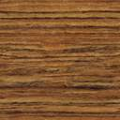

❖ Expression Trees (syntax trees)
§2 Binary Trees
+
〖Example〗 Given an infix expression:
A + B ∗ C / D
A
/
∗
D
☞ Constructing an Expression Tree
(from postfix expression)
B
C
〖Example〗 ( a + b ) * ( c * ( d + e ) ) =
a b + c d e + * *
a
+
+
b
*
c
c
d
*
e
+
T₂
T₂
a
a
+
b
b
c
T₁
d
*
+
e
T₁
T₁
a
b
c
d
+
e
T₁
T₂
T₂
d
e
8/16

Slide 33
§2 Binary Trees
❖ Threaded Binary Trees
Because I enjoy giving
you headaches ... Just kidding.
Okay, think of a full
binary tree with n nodes.
How many links are there?
Here comes
the typical question of mine:
Why do we need
threaded binary trees?
Any clue on how to
improve the situation?
We can replace
the null links by “threads”
which will make traversals
easier.
Then who should
take the credit?
They are
A. J. Perlis and C. Thornton.
You are such a
genius !
n + 1.
Oh well,
I wish I’d have really done it
Of course not!
How many of them
are NULL?
You got it!
Can I stand that?
14/16

Slide 34
§2 Binary Trees
Rule 1: If root->lcl is null, replace it with a pointer to the inorder predecessor of Tree.
Rule 2: If root->rcl is null, replace it with a pointer to the inorder successor of Tree.
Rule 3: There must not be any loose threads. Therefore a threaded binary tree must have a head node of which the left child points to the first node.
class ThreadedTreeNode {
int LeftThread; /* if it is TRUE, then Left */
ThreadedTree Left; /* is a thread, not a child ptr. */
ElementType Element;
int RightThread; /* if it is TRUE, then Right */
ThreadedTree Right; /* is a thread, not a child ptr. */
}
15/16

Slide 35
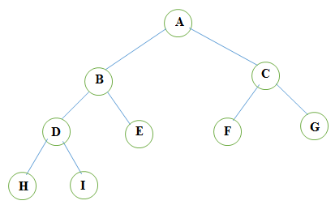
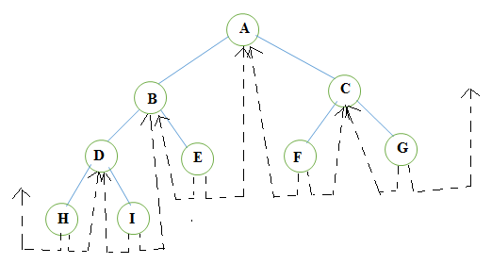

Slide 36
Assume that ptr is an arbitrary node in a threaded binary tree, then the following constraints hold:
If ptr->leftThread = TRUE or 1, then ptr->lcl contains thread.
If ptr->rightThread = TRUE or 1, then ptr->rcl contains thread.
Traditionally, root->rlink = root and root->rightThread = 0 for any threaded binary tree.
The root points to the header node of the tree, while root->llink points to the start of the first node of the actual tree.
The loose thread from the right most node and the left most node is handled by having them pointed to the header node.

Slide 37
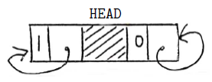
Empty Threaded BT

Slide 38
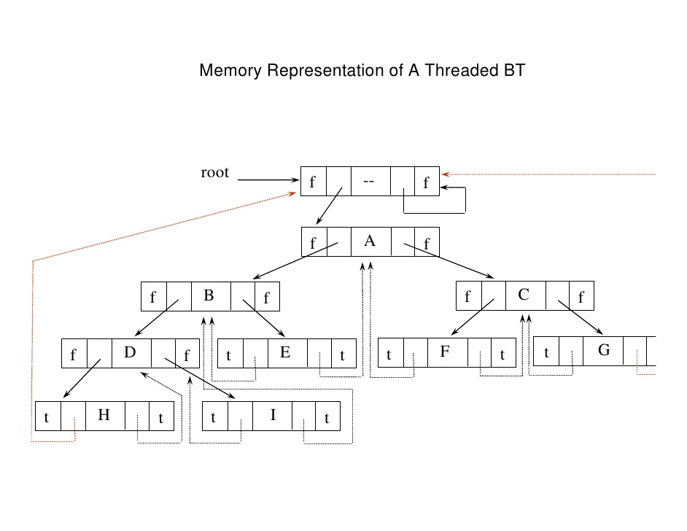

Slide 39
§2 Binary Trees
〖Example〗 Given the syntax tree of an expression (infix)
A + B ∗ C / D
head node
+
F
F
A
/
∗
D
F
+
F
B
C
T
A
T
F
/
F
F
∗
F
T
D
T
T
B
T
T
C
T
16/16

Slide 40
void tinorder(node *root)
{
node *temp=root;
for(;;)
{
temp=in_suc(temp);
if(temp==root)
break;
cout<<temp->info;
}
}
node *in_suc(node *root)
{
node *temp;
temp=root->rlink;
if(!root->rthread)
{
while(!temp->lthread)
temp=temp->llink;
}
return temp;
}

